Slide 1


Correlation and Regression
Associate Professor
Department of Computer Science and Engineering

Slide 2
Session Objectives
Understanding Correlation
Understanding Regression
Regression Analysis in Business

Slide 3
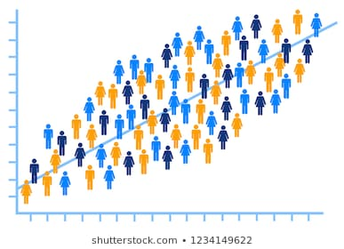
Correlation
Finding the relationship between two quantitative variables without being able to infer causal relationships.
Causal relation is the link between the two things in which one causes another.
Correlation is a statistical technique used to determine the degree to which two variables are related

Slide 4
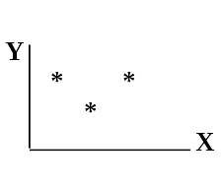
Correlation Representation
Scatter diagram
Rectangular coordinate
Two quantitative variables
One variable is called independent (X) and the second is called dependent (Y)
Points are not joined
No frequency table

Slide 5
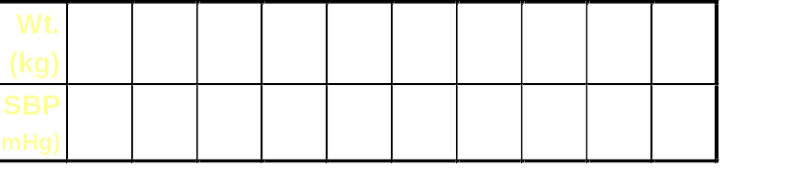
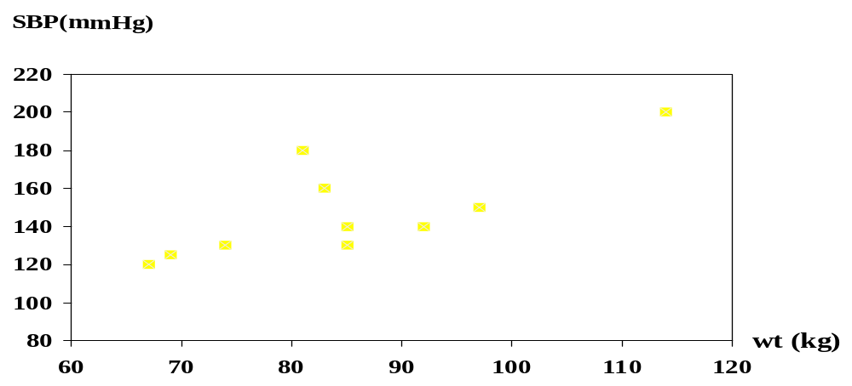
Example: Scatter diagram of weight and systolic blood pressure

Slide 6
Finding the type of Relation from Graph
The pattern of data is indicative of the type of relationship between two variables:
positive relationship
negative relationship
no relationship

Slide 7
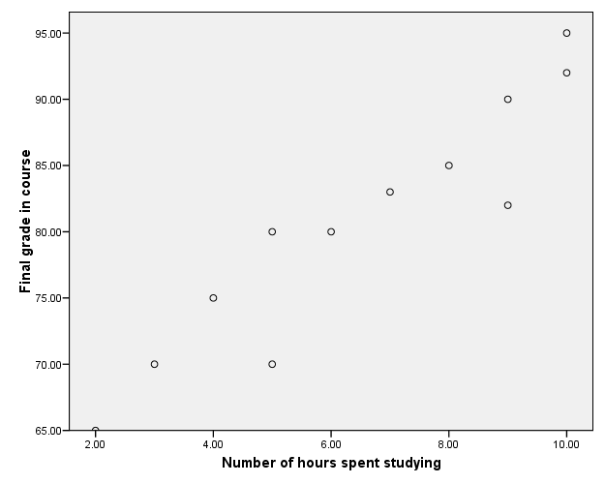
Positive Relationship

Slide 8
Negative Relationship
Reliability
Age of Car

Slide 9
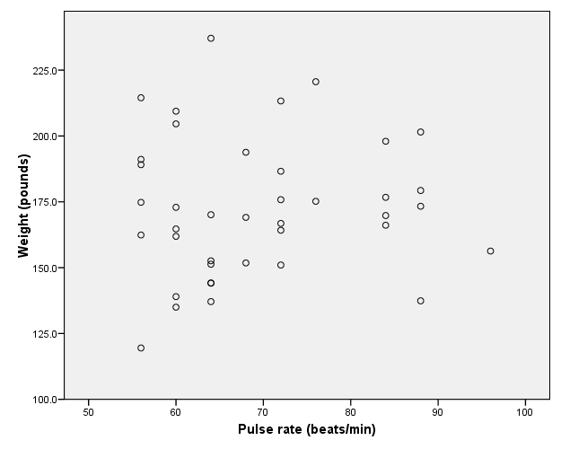
No Relationship

Slide 10
Correlation Coefficient (r)
Statistic that shows the degree of relation between two variables.
It is also called Pearson's correlation.
It measures the nature and strength between two variables of the quantitative type.
The sign of r denotes the nature of association
The value of r denotes the strength of association.
If the sign is +ve this means the relation is direct (an increase in one variable is associated with an increase in the
other variable and a decrease in one variable is associated with a decrease in the other variable).
While if the sign is -ve this means an inverse or indirect relationship (which means an increase in one variable is associated with a decrease in the other).

Slide 11
Value of (r)
The value of r ranges between ( -1) and ( +1)
The value of r denotes the strength of the association as illustrated by the following diagram.
strong
intermediate
weak
weak
intermediate
strong
-1
-0.75
-0.25
0
0.25
0.75
1
indirect
Direct
perfect correlation
perfect correlation
no relation

Slide 12
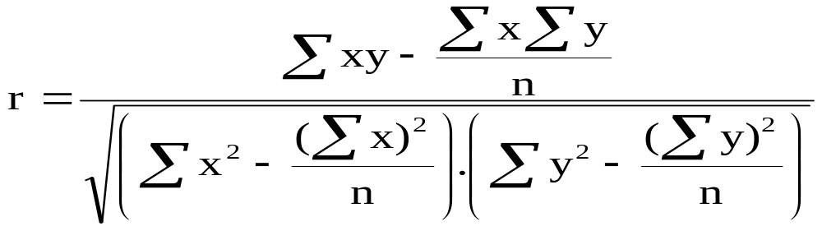
To compute the simple correlation coefficient (r)

Slide 13
Activity 1
A sample of 6 children was selected, data about their age in years and weight in kilograms was recorded as shown in the following table. It is required to find the correlation between age and weight.
serial No | Age (years) | Weight (Kg)
1 | 7 | 12
2 | 6 | 8
3 | 8 | 12
4 | 5 | 10
5 | 6 | 11
6 | 9 | 13

Slide 14
Activity 1: Solution
The 2 variables are of the quantitative type, one variable (Age) is called the independent and denoted as (X) variable and the other (weight) is called the dependent and denoted as (Y) variables to find the relation between age and weight compute the simple correlation coefficient using the following formula:

Slide 15
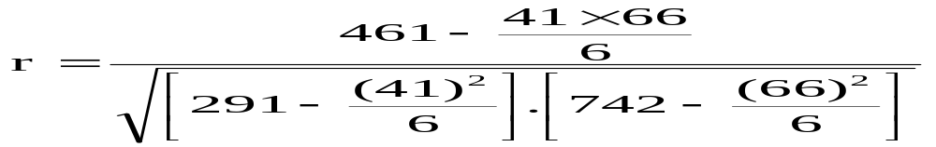
Serial n. | Age (years) (x) | Weight (Kg) (y) | xy | X² | Y²
1 | 7 | 12 | 84 | 49 | 144
2 | 6 | 8 | 48 | 36 | 64
3 | 8 | 12 | 96 | 64 | 144
4 | 5 | 10 | 50 | 25 | 100
5 | 6 | 11 | 66 | 36 | 121
6 | 9 | 13 | 117 | 81 | 169
Total | ∑x= 41 | ∑y= 66 | ∑xy= 461 | ∑x2= 291 | ∑y2= 742
r = 0.759
strong direct correlation

Slide 16
Relationship between Anxiety and Test Scores
Activity 2
Anxiety (X) | Test score (Y) | X² | Y² | XY
10 | 2 | 100 | 4 | 20
8 | 3 | 64 | 9 | 24
2 | 9 | 4 | 81 | 18
1 | 7 | 1 | 49 | 7
5 | 6 | 25 | 36 | 30
6 | 5 | 36 | 25 | 30
∑X = 32 | ∑Y = 32 | ∑X² = 230 | ∑Y² = 204 | ∑XY=129

Slide 17
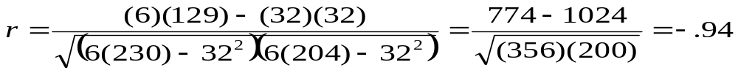
Calculating Correlation Coefficient
r = - 0.94
Indirect strong correlation

Slide 18
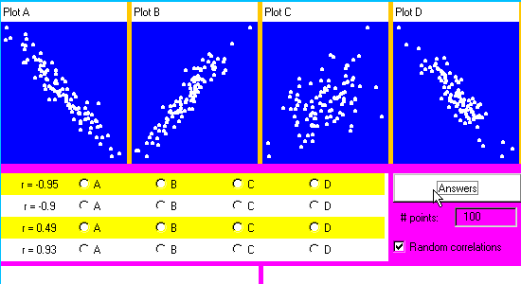
Activity 3

Slide 19
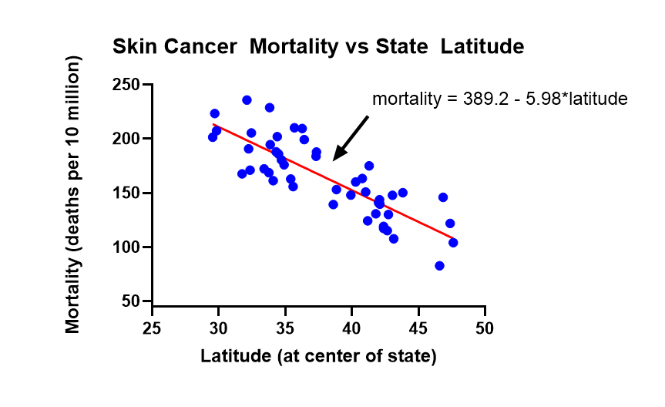
Regression Analyses
Regression: technique concerned with predicting some variables by knowing others. Like predicting variable Y using variable X.

Slide 20
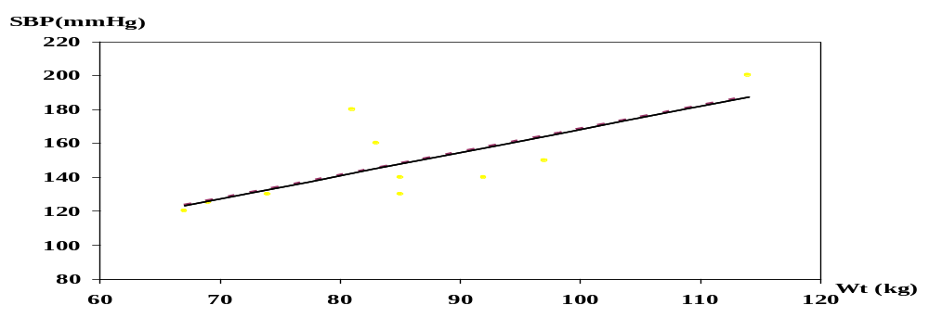
Correlation Vs Regression
Correlation describes the strength of a linear relationship between two variables
Linear means “straight line”
Regression tells us how to draw the straight line described by the correlation

Slide 21
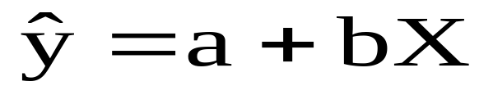
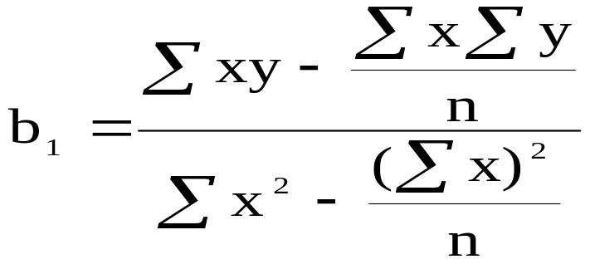

Regression Line
By using the least squares method (to calculate value of a and b) we are able to construct a best fitting straight line to the scatter diagram points and then formulate a regression equation in the form of:
Notes:
The parameter “a” tells about the level of the fitted line, i.e. the distance of a line above or below the origin and parameter “b” tells about the slope of the line, i.e. the change in the value of Y for one unit of change in X

Slide 22
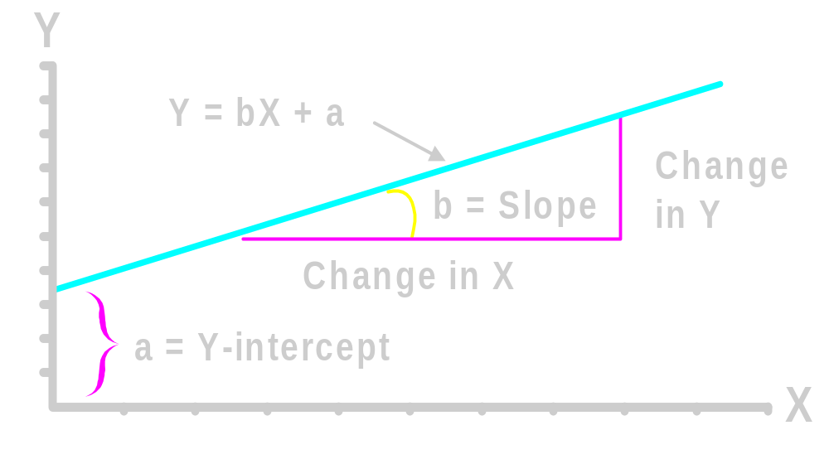
Regression Equation
Regression equation describes the regression line mathematically
  Intercept
  Slope

Slide 23
Example: Hours studying and grades

Slide 24
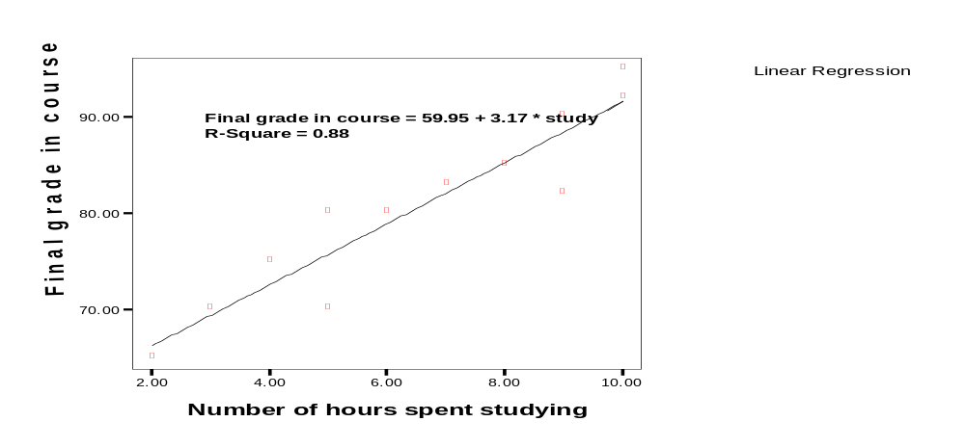
Regressing grades on hours
Predicted final grade in class = 59.95 + 3.17*(number of hours you study per week)

Slide 25
Predict the final grade of…
Someone who studies for 12 hours
Final grade = 59.95 + (3.17*12)
Final grade = 97.99
Someone who studies for 1 hour:
Final grade = 59.95 + (3.17*1)
Final grade = 63.12

Slide 26
Exercise 1
A sample of 6 persons was selected the value of their age ( x variable) and their weight is demonstrated in the following table. Find the regression equation and what is the predicted weight when age is 8.5 and 7.5 years.
Serial no. | Age (x) | Weight (y)
1 2 3 4 5 6 | 7 6 8 5 6 9 | 12 8 12 10 11 13

Slide 27
Answer
Serial no. | Age (x) | Weight (y) | xy | X² | Y²
1 2 3 4 5 6 | 7 6 8 5 6 9 | 12 8 12 10 11 13 | 84 48 96 50 66 117 | 49 36 64 25 36 81 | 144 64 144 100 121 169
Total | 41 | 66 | 461 | 291 | 742

Slide 28
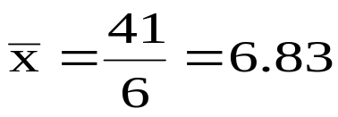
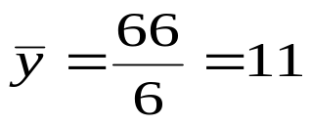
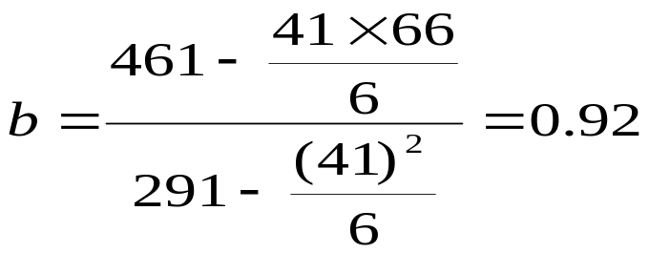
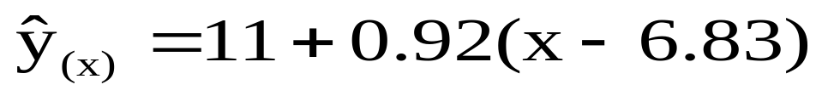
Regression equation

Slide 29
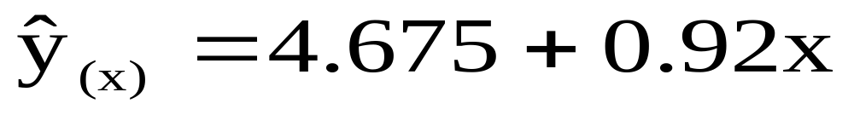

Slide 30
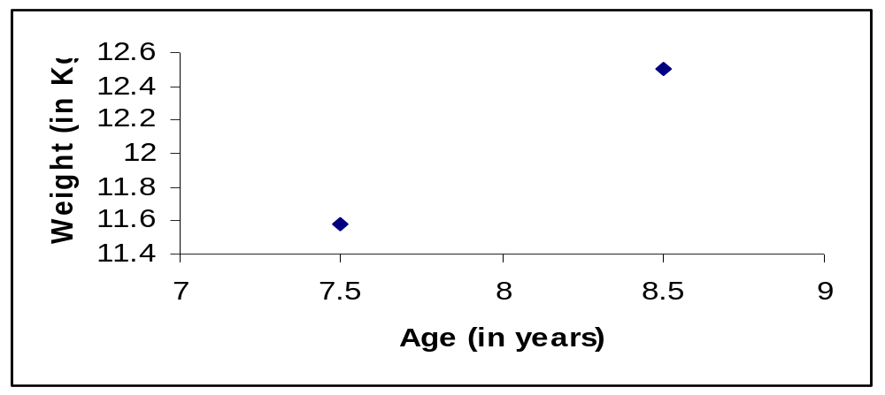
we create a regression line by plotting two estimated values for y against their X component, then extending the line right and left.

Slide 31
Exercise 2
The following are the age (in years) and systolic blood pressure of 20 apparently healthy adults.
Age (x) | B.P (y) | Age (x) | B.P (y)
20 43 63 26 53 31 58 46 58 70 | 120 128 141 126 134 128 136 132 140 144 | 46 53 60 20 63 43 26 19 31 23 | 128 136 146 124 143 130 124 121 126 123

Slide 32
Find the answer to the following Questions.
Find the correlation between age and blood pressure.
Find the regression equation?
What is the predicted blood pressure for a man aging 25 years?

Slide 33
Serial | x | y | xy | X^2
1 | 20 | 120 | 2400 | 400
2 | 43 | 128 | 5504 | 1849
3 | 63 | 141 | 8883 | 3969
4 | 26 | 126 | 3276 | 676
5 | 53 | 134 | 7102 | 2809
6 | 31 | 128 | 3968 | 961
7 | 58 | 136 | 7888 | 3364
8 | 46 | 132 | 6072 | 2116
9 | 58 | 140 | 8120 | 3364
10 | 70 | 144 | 10080 | 4900
Serial | x | y | xy | X^2
11 | 46 | 128 | 5888 | 2116
12 | 53 | 136 | 7208 | 2809
13 | 60 | 146 | 8760 | 3600
14 | 20 | 124 | 2480 | 400
15 | 63 | 143 | 9009 | 3969
16 | 43 | 130 | 5590 | 1849
17 | 26 | 124 | 3224 | 676
18 | 19 | 121 | 2299 | 361
19 | 31 | 126 | 3906 | 961
20 | 23 | 123 | 2829 | 529
Total | 852 | 2630 | 114486 | 41678

Slide 34
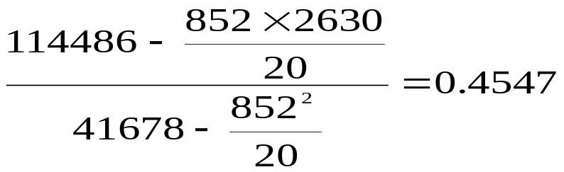

=
=112.13 + 0.4547 x
for age 25
B.P = 112.13 + 0.4547 * 25=123.49 = 123.5 mm hg

Slide 35
Uses of Regression Analysis in Business
1. Predictive Analytics:
Predictive analytics i.e. forecasting future opportunities and risks is the most prominent application of regression analysis in business.
Demand analysis, for instance, predicts the number of items which a consumer will probably purchase.
Regression analysis can go far beyond forecasting impact on direct revenue. For example, we can forecast the number of shoppers who will pass in front of a particular billboard and use that data to estimate the maximum to bid for an advertisement.
Insurance companies heavily rely on regression analysis to estimate the credit standing of policyholders and a possible number of claims in a given time period.

Slide 36
Uses of Regression Analysis in Business
2. Operation Efficiency:
Regression models can also be used to optimize business processes.
A factory manager, for example, can create a statistical model to understand the impact of oven temperature on the shelf life of the cookies baked in those ovens.
In a call center, we can analyze the relationship between wait times of callers and number of complaints.
Data-driven decision making eliminates guesswork, hypothesis and corporate politics from decision making. This improves the business performance by highlighting the areas that have the maximum impact on the operational efficiency and revenues.

Slide 37
Uses of Regression Analysis in Business
3. Supporting Decisions:
Businesses today are overloaded with data on finances, operations and customer purchases.
Business are now leaning on data analytics to make informed business decisions.
By reducing the tremendous amount of raw data into actionable information, regression analysis leads the way to smarter and more accurate decisions.
4. Correcting Errors:
Regression is not only great for lending empirical support to management decisions but also for identifying errors in judgment. For example, a retail store manager may believe that extending shopping hours will greatly increase sales.
Regression analysis, however, may indicate that the increase in revenue might not be sufficient to support the rise in operating expenses due to longer working hours (such as additional employee labor charges).

Slide 38
Uses of Regression Analysis in Business
5. New Insights:
Over time businesses have gathered a large volume of unorganized data that has the potential to yield valuable insights. However, this data is useless without proper analysis. Regression analysis techniques can find a relationship between different variables by uncovering patterns that were previously unnoticed.
For example, analysis of data from point of sales systems and purchase accounts may highlight market patterns like increase in demand on certain days of the week or at certain times of the year.

Slide 39
Summary
Understand correlation
Finding correlation coefficient (r)
Finding the type of correlation +ve or –ve
Finding the regression line
Predicting the value of one variable by another

Slide 40
Thanks

